Slide 1

DEPARTMENT OF INFORMATION SCIENCE & ENGINEERING
“Quick-Scan”
COURSE NAME : MINI PROJECT
COURSE CODE: 20ISE391A
Presentation by,
NAME: CHETHAN A S
HEMSAGAR N M
USN: 1NH20IS035
1NH20IS062
Under the Guidance of,
Guide Name: Ms.B Swathi
Designation: Professor

Slide 2
Agenda
Introduction
Existing system
Limitations of Existing System
Problem Definition
Proposed system
Objectives
Flow chart
Conclusion

Slide 3
Introduction
Our Idea is to implement the instant ticket inspection by the respective transportation companies by using their database data to inspect the tickets .
This system can installed in the present booking apps like MakeMyTrip, redBus, Bus Booking, ClearTrip etc.
We can use this system in BMTC buses so it will be easy to the inspector to check the tickets when buses are crowded. Manual ticket inspection is a hectic and time consuming process during rush hour and some people without the tickets can run-away from the inspector

Slide 4
Liretarature survey / Existing systems
There is only manual ticket inspection in transportation services and counterfeit tickets can be easily generated and used to get away from the inspection.
Manual ticket inspection done by this transportation inspector has to write done the details of the ticket they inspected into a record

Slide 5
Limitations of Existing Systems
Scope of Improvement of existing systems
We are adding a feature where each and every ticket generated is stored in the database and the transportation department can easily track the loop holes in the system and if the ticket details is not stored in the database the ticket can be inspected as a counterfeit or illegal ticket.
Adding reasonable features
Adding QR code scanner which scans the QR code in the ticket which is unique for each bus and helps in giving details of the bus and rate charges in the tickets.
Limitations:
Time consuming
No proper data collection
Less info regarding the transit

Slide 6
Problem Definition
Point 1
In present day world tickets can be easily counterfeited and used to scam the transportation company to travel free.
Point 2
Some transit conductors may not issue the proper tickets to the people and can try to embezzle the company and the there will no proper collection of ticket data which is been inspected manually.

Slide 7
Proposed System
‘Quick-Scan’ is the name of our proposed system which concerns about inspecting the details of the tickets on inspection and also storing the details data of the tickets for inspection by storing it in the database for the respective transportation company.
The data details of the tickets stored in the database file can used for surveying and monitor the public using their transportation service. Data is money in present day world and by looking into the data respective public transportation company can get an outlook about how their travel business is doing on day-to-day basis.

Slide 8
Quick-scan uses the QR-code/Barcode scanner which detects the QR/Barcode present on the tickets and decodes it into required data form and stores the decoded data into an database or we can use the scanner to inspect the ticket details and the system can detect if the details of the ticket is present in the company’s database or not and provides specific message as an result.
Using a scanner to inspect the tickets is a one of the efficient methods to quickly inspect the tickets and register the ticket’s data into a file and the ticket inspector job is made more productive than inspecting the tickets manually.

Slide 9
Objectives
Objective 1 – Learn how to use Machine Learning in python.
Objective 2 – To stop the loop-holes present in the transit service.
Objective 3 – Creating a small database to collect the data of each and every ticket which has been generated in the transit.
Objective 4 – Inspecting the tickets for the data and to check if its details is registered in the data base using the QR code scanner.

Slide 10

Design Modules
MODULES USED
OpenCV
It is used to use the camera to scan the QR code

Slide 11

NumPy
It is use add the real time user interface graphics to locate the QR code present in the ticket

Slide 12
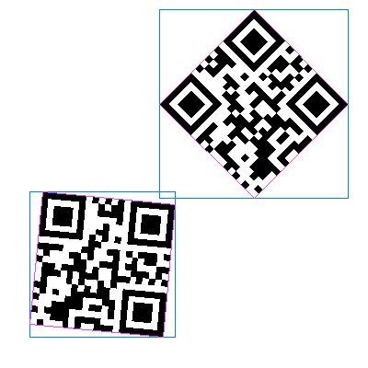
Pyzbar
This is used to decode the QR code and convert it into the required data form the user needs to be

Slide 13
Algorithm
Step 1: Webcam access using cv2 function - cv2.VideoCapture(0), here argument 0 because we are using internal camera of the system.
Step 2: Take input of the database file name.
Step 3: Create a list to store unique decoded data from scanning.
Step 4: Enter the choice according to what operation need to be performed.
Step 5: Open the database file in ‘r+’ mood.
Step 6: Store the each line of the file as a element into a list using readlines.split(\n) function.
Step 7: If choice is “I” – Inspection of the data.
Step 8: Enter number of scans to be performed.
Step 9: Read the frames through the webcam.
Step 10: Detecting the QR/Barcode in the frame and decoding.

Slide 14
Algorithm
Step 11: Displaying the bounding lines around the QR/Barcode.
Step 12: Displaying the decoded data on the frame.
Step 13: If decoded data is present in the database file then print valid else invalid.
Step 14: Display the real time video capturing frame.
Step 15: Close the database file.
Step 16: If choice is “R” – Registering the data.
Step 17: Step10 to Step13 .
Step 18: If the decoded data is not present in the list, append the decoded data into the list.
Step 19: Write the data which has been append to the list into the database file.
Step 20: Step 16 and Step 17 .

Slide 15
Algorithm
Step 21: If choice is not “I”, “R” or “E” – Invalid entry.
Step 22: Print Invalid choice and again ask to enter valid choice.
Step 23: If choice is “E” – Exit
Step 26: Print the Exiting message.
Step 27: Terminate the program.

Slide 16
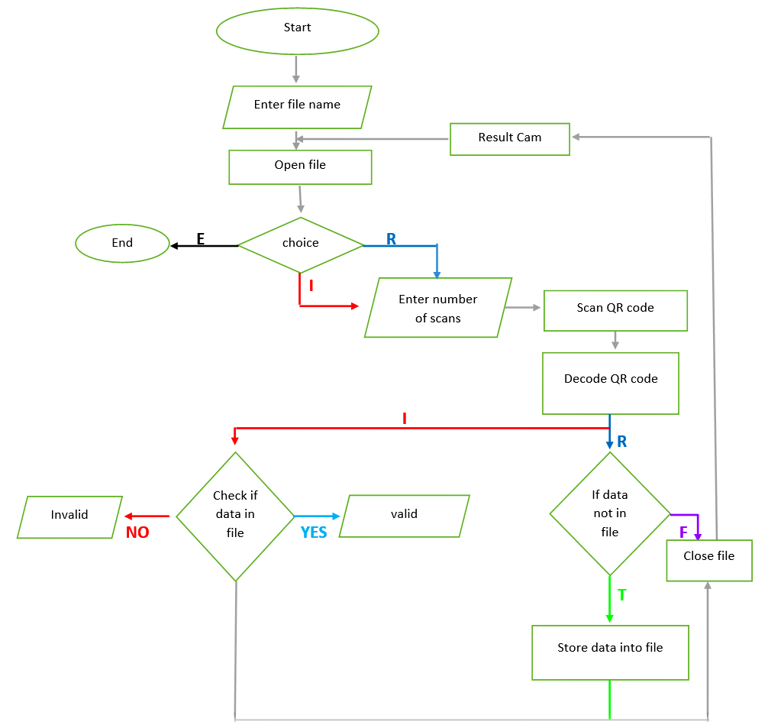
Flowchart

Slide 17
Conclusion
Using our Quick-scan inspection the tickets is made easy to the person inspecting the transit
If there is a huge number of people whose tickets need to be inspected our system is more efficient and helpful rather than manual ticket inspection
Our system shows the real time details of the tickets by scanning the QR code present in the ticket and shows if its data is stored in the database or not.

Slide 18
References
[1] OpenCV with Python: A basic approach by Dr. Panchanand Jha (Author), Dr. Bibhuti Bhusan Biswal (Contributor)
[2] NumPy for Beginners: first Step to learn Data Science by Preeti Saraswat
[3] Python Crash Course, 2Nd Edition: A Hands-On, Project-Based Introduction To Programming
[4] A new encrypted Data hiding algorithm inside a QR Code™ implemented for an Android Smartphone system: S_QR algorithm
[5] http://www.codermaker.org/

Slide 19
Thank you
Queries ?

